Slide 1
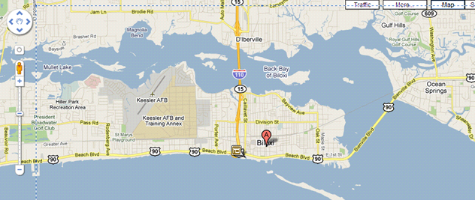
Mississippi Gulf Coast Biloxi, MS
14.5hrs (912mi) from Elmhurst by Coach Bus
Average temperature in March about 70 degrees

Slide 2
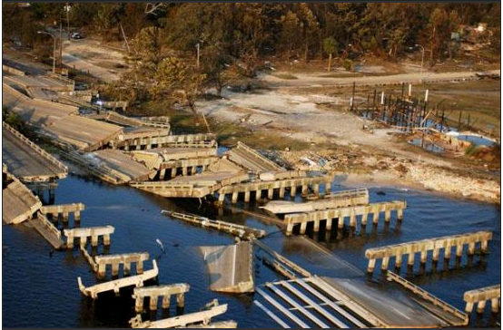
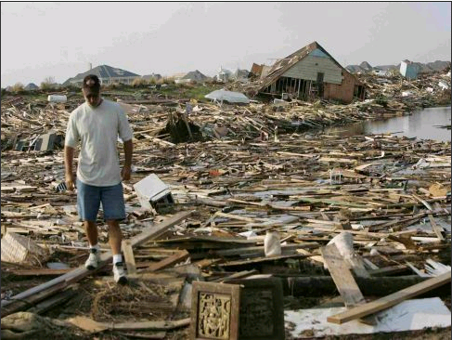
Why They Need Our Help
More storm damage by Hurricane Katrina than New Orleans, but often overlooked
Recent oil spill nearly ruined their economy
Between Katrina & oil spill, do not have the money or resources to rebuild
Enough debris after storm to fill football stadium 97 stories high

Slide 3
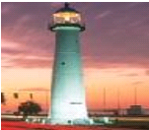
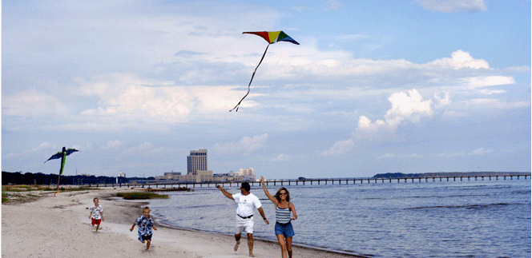
Culture & Activities
Heavily influenced by New Orleans culture
Blues music
Large seafood industry
Lighthouse & Hurricane Katrina memorial
26 miles of beaches
Museums
Outdoor activities
Shopping
Cosmic Bowling

Slide 4
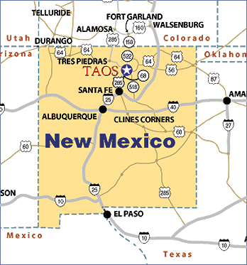
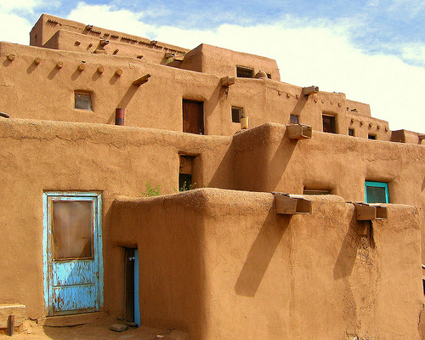
Taos, New Mexico
Population:
Hispanic
Native American
Anglo
23% live below the poverty level
Chance to work on an adobe home!

Slide 5
Basic Info
We’ll be flying!
We’ll be cooking!
Except for one meal provided by the Homeowners
… which means we’ll most likely meet the homeowners!
Staying in a Church

Slide 6
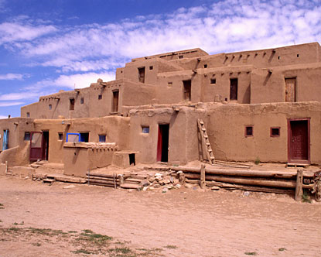
Attraction Possibilities
1000+ year old Pueblo
Earthship Communities
River Rafting
Hiking
Hot Springs
Art Community
Cultural & Historical Tours & Museums

Slide 7
New Horizons, Habitat For Humanity Americus, Georgia
Originally part of Habitat International has built houses in Sumter County since 1979. In 1992, Habitat created the Sumter County Initiative, a program designed to eliminate poverty housing throughout Sumter County. Since that time the New Horizons affiliate has built over 480 houses.

Slide 8
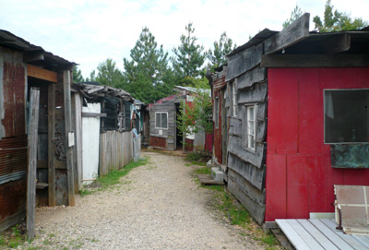
Americus
Original Site of Habitat for Humanity
Home to Habitat for Humanity International Headquarters
ReStore
Anderson POW memorial
Habitat for Humanity Global Village

Slide 9
Americus
Stopping in Nashville, TN
Housing: Volunteer Center or University Campus
Georgia Southwestern State University
Building Houses, Working at the ReStore, and having FUN!

Slide 10
Sea Island, South Carolina
John’s Island, SC
-934 miles away from Elmhurst College
-Group of 25 people
-Staying in Volunteer Houses
-30 minutes from Downtown Charleston
-Area is in great need of affordable housing due to generations of being separated from the mainland and having an influx of development on the islands.

Slide 11
Charleston
-Oldest and 2nd Biggest city in South Carolina
-2009 estimated population: 124,593
-Fastest growing city in SC. The population has went up almost 30% since 2000 and has nearly doubled from the last 30-40 years.
-Known as the “Holy City” for the many churches that dominate the city’s skyline.
-The entire downtown area of Charleston is registered as a National Historical Landmark. Charleston has over 3,000 buildings classified as historic.

Slide 12
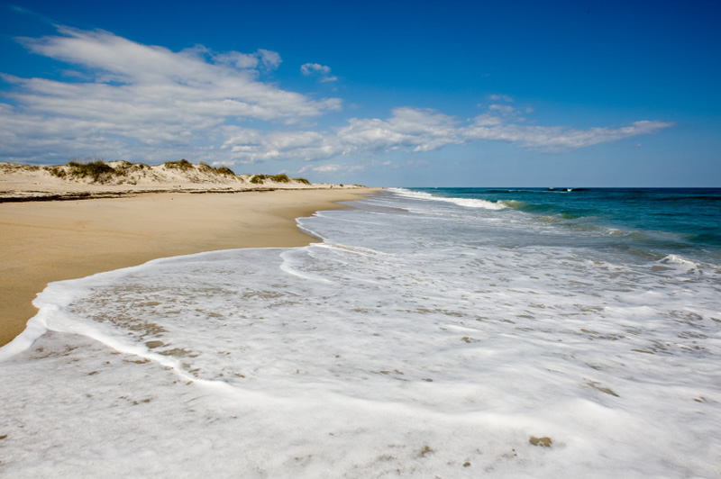
What to do there?
-Beaches 5 minutes away from volunteer houses.
-Kayaking
-Many historic buildings and spots to visit in downtown Charleston.
-Ft. Sumter: The site of the first shots of the Civil War lies in Charleston Bay.

Slide 13
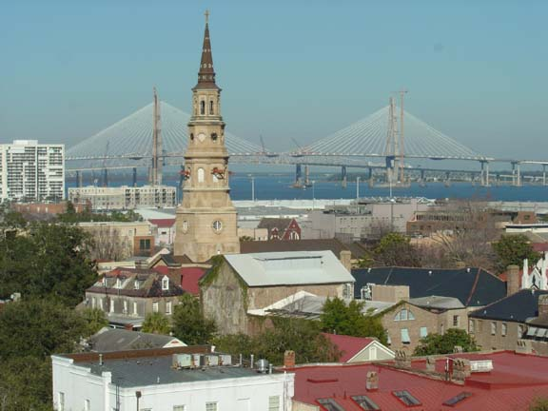
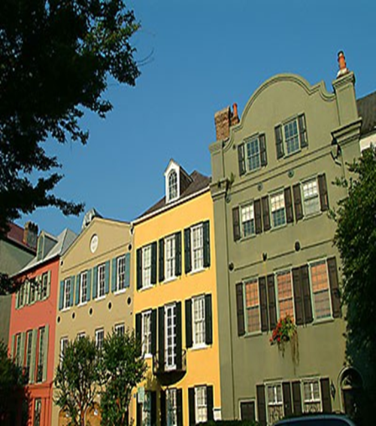
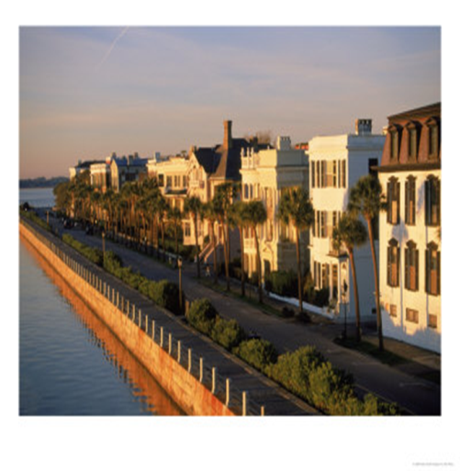
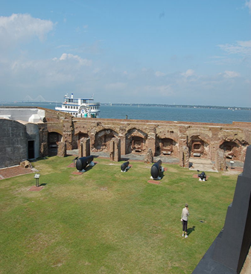
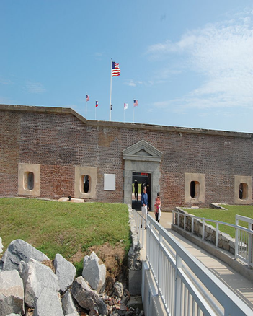
What to see…
Ft. Sumter

